Slide 1

Threat Actors, Attacks, and Mitigation

Slide 2
Threat Actors

Slide 3
Threat
Threat is any incident that could negatively affect an asset – for example, if it’s lost, knocked offline or accessed by an unauthorized party.

Slide 4
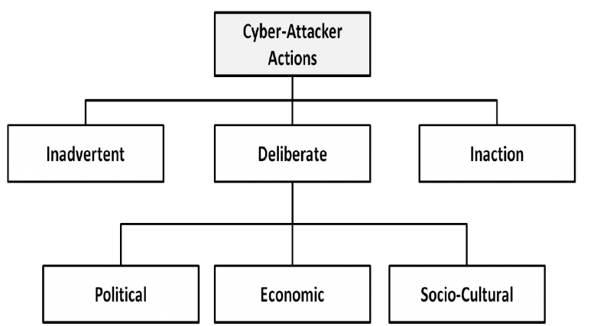
Threat Actors

Slide 5
Attacks

Slide 6
Active Attack
Active attacks: An active attack is a network exploit in which a hacker attempts to make changes to data on the target or data en route to the target.

Slide 7
Types of Active attacks:
Masquerade: in this attack, the intruder pretends to be a particular user of a system to gain access or to gain greater privileges than they are authorized for. A masquerade may be attempted through the use of stolen login IDs and passwords, through finding security gaps in programs or through bypassing the authentication mechanism.
Session replay: In this type of attack, a hacker steals an authorized user’s log in information by stealing the session ID. The intruder gains access and the ability to do anything the authorized user can do on the website.

Slide 8
Types of Active attacks
Message modification: In this attack, an intruder alters packet header addresses to direct a message to a different destination or modify the data on a target machine.
In a denial of service (DoS) attack, users are deprived of access to a network or web resource. This is generally accomplished by overwhelming the target with more traffic than it can handle.
In a distributed denial-of-service (DDoS) exploit, large numbers of compromised systems (sometimes called a botnet or zombie army) attack a single target.

Slide 9
Passive Attack
Passive Attacks: Passive attacks are relatively scarce from a classification perspective, but can be carried out with relative ease, particularly if the traffic is not encrypted.

Slide 10
Types of Passive Attack
Types of Passive attacks:
Eavesdropping (tapping): the attacker simply listens to messages exchanged by two entities. For the attack to be useful, the traffic must not be encrypted. Any unencrypted information, such as a password sent in response to an HTTP request, may be retrieved by the attacker.

Slide 11
Types of Passive Attacks
Traffic analysis: the attacker looks at the metadata transmitted in traffic in order to deduce information relating to the exchange and the participating entities, e.g. the form of the exchanged traffic (rate, duration, etc.). In the cases where encrypted data are used, traffic analysis can also lead to attacks by cryptanalysis, whereby the attacker may obtain information or succeed in unencrypting the traffic.
Software Attacks: Malicious code (sometimes called malware) is a type of software designed to take over or damage a computer user's operating system, without the user's knowledge or approval. It can be very difficult to remove and very damaging.

Slide 12
Types of Attacks

Slide 13
Types of Attacks
Types of Cyber Attacks
A cyber-attack is an exploitation of computer systems and networks. It uses malicious code to alter computer code, logic or data and lead to cybercrimes, such as information and identity theft.
Cyber-attacks can be classified into the following categories:
1) Web-based attacks
2) System-based attacks

Slide 14
Web-based attacks

Slide 15
Types of Attacks
1. Injection attacks
It is the attack in which some data will be injected into a web application to manipulate the application and fetch the required information.
Example- SQL Injection, code Injection, log Injection, XML Injection etc.

Slide 16
SQL Injection attacks
1. SQL Injection attacks
It is the attack in which some data will be injected into a web application to manipulate the application and fetch the required information.
Example- SQL Injection, code Injection, log Injection, XML Injection etc.

Slide 17
Injection attacks
1. Injection attacks
It is the attack in which some data will be injected into a web application to manipulate the application and fetch the required information.
Example- SQL Injection, code Injection, log Injection, XML Injection etc.

Slide 18
DNS Spoofing
2. DNS Spoofing
DNS Spoofing is a type of computer security hacking. Whereby a data is introduced into a DNS resolver's cache causing the name server to return an incorrect IP address, diverting traffic to the attackers computer or any other computer.
The DNS spoofing attacks can go on for a long period of time without being detected and can cause serious security issues.

Slide 19
DNS Spoofing
3. Session Hijacking
It is a security attack on a user session over a protected network. Web applications create cookies to store the state and user sessions.
By stealing the cookies, an attacker can have access to all of the user data.

Slide 20
DNS Spoofing
4. Phishing
Phishing is a type of attack which attempts to steal sensitive information like user login credentials and credit card number. It occurs when an attacker is masquerading as a trustworthy entity in electronic communication.
5. Brute force
It is a type of attack which uses a trial and error method. This attack generates a large number of guesses and validates them to obtain actual data like user password and personal identification number. This attack may be used by criminals to crack encrypted data, or by security, analysts to test an organization's network security.

Slide 21
DNS Spoofing
6. Denial of Service
It is an attack which meant to make a server or network resource unavailable to the users. It accomplishes this by flooding the target with traffic or sending it information that triggers a crash. It uses the single system and single internet connection to attack a server. It can be classified into the following-
Volume-based attacks- Its goal is to saturate the bandwidth of the attacked site, and is measured in bit per second.
Protocol attacks- It consumes actual server resources, and is measured in a packet.
Application layer attacks- Its goal is to crash the web server and is measured in request per second.

Slide 22
DNS Spoofing
7. Dictionary attacks
This type of attack stored the list of a commonly used password and validated them to get original password.
8. URL Interpretation
It is a type of attack where we can change the certain parts of a URL, and one can make a web server to deliver web pages for which he is not authorized to browse.
9. File Inclusion attacks
It is a type of attack that allows an attacker to access unauthorized or essential files which is available on the web server or to execute malicious files on the web server by making use of the include functionality.

Slide 23
DNS Spoofing
10. Man in the middle attacks
It is a type of attack that allows an attacker to intercepts the connection between client and server and acts as a bridge between them. Due to this, an attacker will be able to read, insert and modify the data in the intercepted connection.

Slide 24
System-based attacks

Slide 25
Virus
1. Virus
It is a type of malicious software program that spread throughout the computer files without the knowledge of a user. It is a self-replicating malicious computer program that replicates by inserting copies of itself into other computer programs when executed. It can also execute instructions that cause harm to the system.

Slide 26
Virus
2. Worm
It is a type of malware whose primary function is to replicate itself to spread to uninfected computers. It works same as the computer virus. Worms often originate from email attachments that appear to be from trusted senders.

Slide 27
Virus
3. Trojan horse
It is a malicious program that occurs unexpected changes to computer setting and unusual activity, even when the computer should be idle. It misleads the user of its true intent. It appears to be a normal application but when opened/executed some malicious code will run in the background.
4. Backdoors
It is a method that bypasses the normal authentication process. A developer may create a backdoor so that an application or operating system can be accessed for troubleshooting or other purposes.

Slide 28
Virus
5. Bots
A bot (short for "robot") is an automated process that interacts with other network services. Some bots program run automatically, while others only execute commands when they receive specific input. Common examples of bots program are the crawler, chatroom bots, and malicious bots.

Slide 29
Thank You

